Slide 1
Safety Moment / Alert

Slide 2
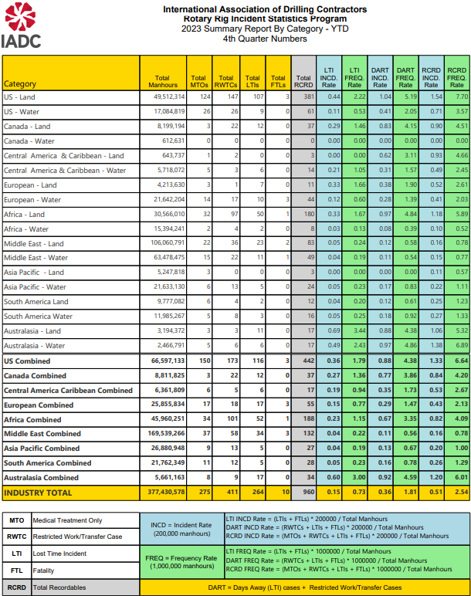

Slide 3
ISP PROGRAM UPGRADES
On 22 January 2024, IADC officially launched its new tracking system for the Incident Statistics Program (ISP) by sending out usernames and passwords to participants. There are currently 75 participating companies in the ISP, representing more than 80% of all active drilling activity globally.
For IADC’s Drilling Contractor Members that do not currently have their own system or database to track incidents and hours, the new ISP system can be used for this purpose at no cost.
This new web-based system will create a complete paradigm shift in the way the program operates by putting the individual participant in the driver’s seat. For the first time users will have direct access to upload data into the system, as well as on-demand access to reports containing sophisticated visual analytics.

Slide 4
ISP PROGRAM UPGRADES
In addition to having access to real-time reporting on demand, users of the new system will also now have the option to add the day of the week an incident occurred, instead of reporting only by month.
Users will also have the option to track whether an incident is a Serious Injury or Fatality (SIF) along with a space to add a comment with more information, which will enable more nuanced reporting.
The ability to track SIFs could give the industry new insights and assist the IADC Health, Safety, Environment & Training (HSET) Committee—alongside other industry groups and organizations—in crafting a more widely agreed upon definition for SIFs.

